Slide 1

Data Analyst Portfolio
Robert Indelicato

Slide 2

About Me
My name is Robert, and I am an aspiring data analyst with 4 years of experience as a Research Analyst. Results-oriented Business Analyst skillful in managing and breaking down large volumes of information. Proactive at heading off issues in operations, workflow, and production by uncovering trends affecting business success. An efficient team member with a collaborative approach to completing projects and mentoring/training new employees to become professional analysts. Passionate about increasing knowledge to drive career growth. During my Career Foundry course, I became experienced in data cleaning and analyzing in Excel, SQL, and Python. My curiosity drives me to uncover facts in the data sets and my sense of aesthetics to interpret and convey results through effective storytelling in Tableau. I'm enthusiastic about new opportunities to enhance my skills.

Slide 3
Skills
ANALYTICAL SKILLS
Data Mining
Data Cleaning
Data Merging
Descriptive Analysis
Deriving Variables
Data storytelling
TOOLS
SQL
Python
Tableau
Excel

Slide 4
Projects
GameCo – Market Analysis
Influenza – Forecasting
Rockbuster Stealth – SQL
Instacart – Python Analysis
Pig E. Bank – Big Data Analysis

Slide 5





Tools
Microsoft Excel
Tableau
SQL
Python
Github

Slide 6

GameCo
Perform descriptive analysis & recommendations to improve company sales based on their historical data.

Slide 7

Goal, Data limitation, and Skills
Data Source https://images.careerfoundry.com/public/courses/intro-to-data/Project_Brief_Intro_to_Data_Analytics.pdf Tools:
Perform Descriptive Analysis of Video Game Market Data from 1980 to 2016 and provide insights about how GameCo’s new game will fare in the market
It tracks the total number of units sold, but it does not represent financial figures. Data has time limitation, since shows information from 1980 to 2016 only, which probably does not represent the current market. Data from 2016 is incomplete. Some top rank games sales data show inconsistencies, as they show zero sales in certain market, i.e. Gta V in Japan, even though sold millions of copies.
Data Cleaning
Data Grouping and Summarizing
Descriptive Analysis
Pivot Table
Visualization Charts in MS Excel/PowerPoint

Slide 8
Overview
A closer look at 2001-2016 since this was the first year Sony, Nintendo & Microsoft platforms manufacturers had the market share of games.
The Sony PlayStation leads in the Top three biggest Genres in terms of global unit sales which are Action, Sports and Shooter.
Although Nintendo Clearly leads in puzzles, this Genre is the smallest category.

Slide 9
Market Analysis
Description of Graphs
Five-year regional Sales Trend by Platform
Sony is the dominant platform as compared to Microsoft and Nintendo
2016 has the least sales across the three platforms.
Sony European sales have been trending upward and have surpassed North American sales with the exception of 2016.
Microsoft & Nintendo sales have been trending downwards
Japan sales are mostly Nintendo and Sony although sales for both have been trending downward.

Slide 10
Summary
Sony has the most publishers making games for its Platforms.
Nintendo is losing market share rapidly.
Although Sales have been on decline across the three major Gaming Platforms since 2008, Sony is the dominant Gaming Platform leading in Sales globally.
Historically North America has been the largest sales region for Sony however, its European sales have surpassed North American sales in the last several years.
Action, Sports and Shooter are the top three genres and Sony leads in these categories.
Sony should continue to focus on European Sales and look into why North American sales are slowly in decline.
Further investments in the top three genres (Action, Shooter & Sports) may improve sales.

Slide 11

Influenza Season
Perform descriptive analysis based on influenza historical data to provide recommendations based on trends in influenza and how the medical staffing agency should plan for staffing needs across the country

Slide 12
Goal, Data limitation, and Skills
Data Source Project Brief Population Data - By US Census Bureau Influenza Deaths - By CDC Influenza Visits Data Set - By CDC Influenza Lab Test Data Set - By CDC Survey of Flu Shots in Children - By CDC Tools:
Analyze US Influenza Season data and support the medical staffing agency to develop an action plan and determine when and where to send the additional staff, to treat the extra patients .
Population Data: Time Lag it is present, since the US census population data is carried each 10 years, which means it may lead to misinterpretation about the US population depending when it is consulted. In this case, the data in this project is from 2009 to 2017, thus it does not represent the current reality of the US population.
Influenza Deaths: it was possible to noticed omitted information as the raw data has 8% of their information as "Not Stated" and 81% as "Surpressed". Thus, the analysis and recommendations were limited to the elderly population (65+ years), even though the vulnerable group involves a wider category of people, such as pregnant or children under 59 months.
Data Profiling and Integrity Data Quality Measures Data Transformation and Integration Hypothesis Testing Data visualization and Storytelling with Tableau

Slide 13
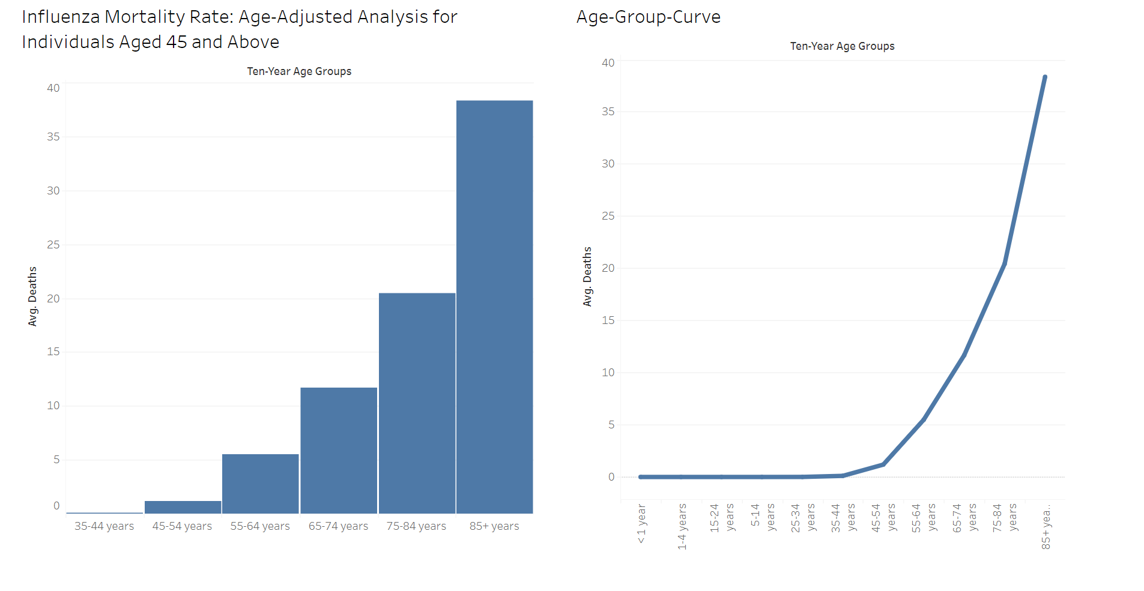
Influenza Mortality Rate by age-group
I intergraded the age groups into 10-year age groups
Ages 35-44 years don’t have the highest mortality rate.
If these people are not helped, they will likely pass away.

Slide 14
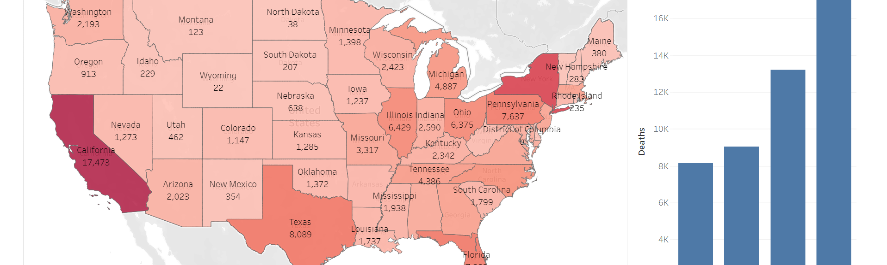
States with highest influenza mortality rates by individuals aged 45 and above
The Heat Map shows California, New York and Texas are the highest States with total deaths.
The Bar Graph shows the deaths in seasonality: Summer, Fall, Spring, and Winter. Winter has the highest death rates since cold weather affects our bodies.

Slide 15

Recommendations
As previously slated, Influenzas ranks within top 10 for the highest mortality rate and particularly amongst the elderly's ages 45 and above. With more efficient deployment of medical resources, we can help to flatten the curve and improve patients care. I recommend several proactive measures.:
Deploy medical resources to Staes based on the Influenzas Death Rate proportions outlined in the treemap.
Increase providing flue Shits in Staes with higher per capita death rate during the CDC recommended months by September and October.
Improve patient care by increasing the number of providers to Staes with a higher patient-to-provider ratio

Slide 16
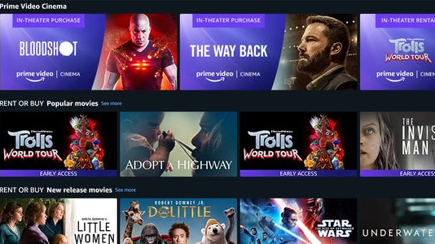
Rockbusters
Analyze Rockbusters data through SQL queries and provide answer to all ad-hoc business questions from various departments inside the company to support them in the release of an online video rental service

Slide 17
Goal, Data limitation, and Skills
Data Source https://images.careerfoundry.com/public/courses/data-immersion/A3/A3_Data_Project_Brief%20.pdf Tools:
Provide support to Rockbuster Stealth's Business Intelligence department to help with the launch strategy for their new online video service.
The data provided serves to show the customer base, films, categories, employees, among other information related to the company's operation. However, it does not provide information related to historical data or that would allow a market trend analysis or forecast..
Filtering Data in SQL
Summarizing and Cleaning Data in SQL
Joining Tables
Performing Subqueries
Common Tables Expression
Presenting SQL Results
Visualization and Storytelling in Tableau

Slide 18
Overall Analysis
1,000 unique films
17 Genres
Only one language: English
599 customers
Length: Average 115 minutes Minimum 46 minutes Maximum 185 minutes
Rental Days: Average 5 days Minimum 3 days Maximum 7 days
Replacement Cost Average $ 19,98 Minimum $ 9,99 Maximum $ 29,99

Slide 19
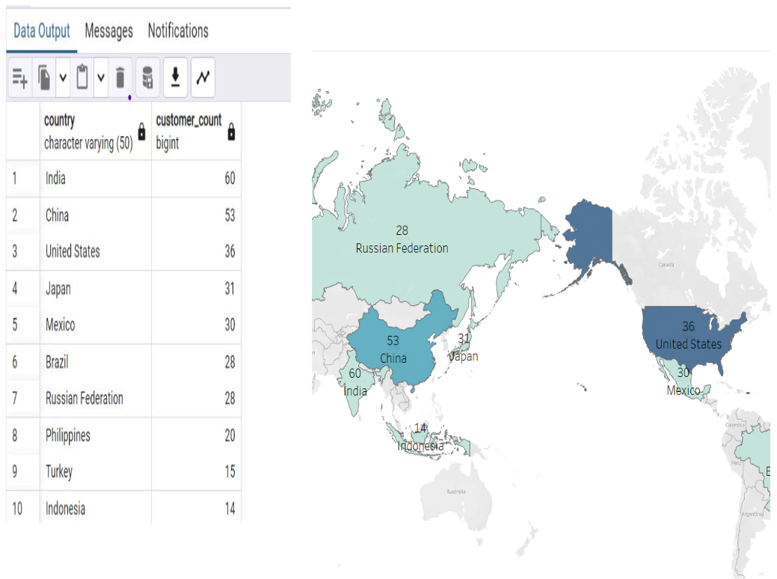
Overall Analysis
Rockbuster customers are spread around the world in 108 distinct countries. The top 10 countries in terms of number of customers are India, China, United States, Japan, Mexico, Brazil, Russian Federation, Philipines, Turkey, Indonesia

Slide 20
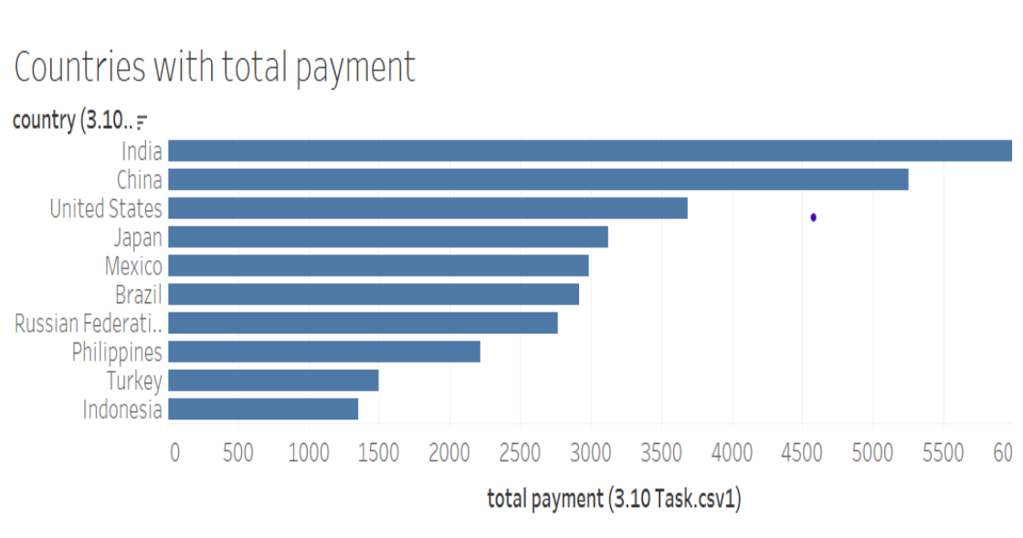
Overall Analysis
10 countries have revenue greater than 1.000. The top 10 countries in terms of customers are the same top 10 countries with higher revenue.

Slide 21
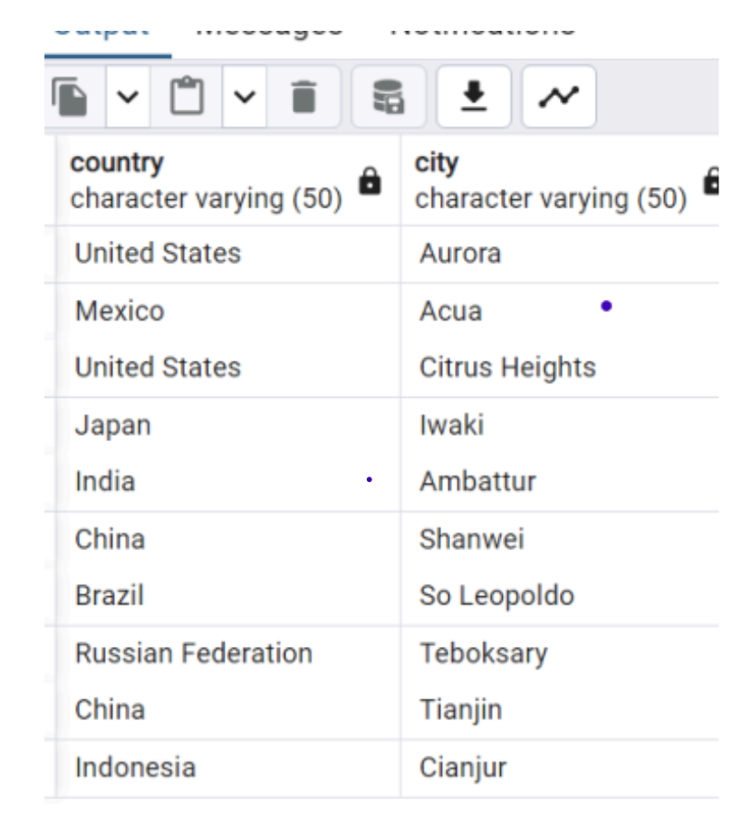
IN WHICH CITIES DO THE CUSTOMERS LIVE
Within the Top 10 countries the top cites are:
Aurora, United States Acua, Mexico Cireus Heights, United States Iwaki, Japan Ambattur, India Shanwei, China So Leopoldo, Brazil Teboksary, Russian Federation Tianjin, China Cianjur, Indonesia

Slide 22
WHO ARE THE TOP 5 CUSTOMERS?
1. Arlene Harvey From Ambattur, India $ 111,76
2. Kyle Spurlock From Shanwei, China $ 109,71
3. Marlene Welch From Iwaki, Japan $ 106,77
4. Glen Talbert From Acua, Mexico $ 100,77
5. Clinton Buford From Aurora, United States $ 98,76

Slide 23
Recommendations
Increase offer in terms of:
Number of films
Genre
Language
Pricing
Differentiate the price according to the duration of the rental
Create a loyalty scheme
Working together with the top clients and promoting them as Rockbuster Ambassadors, the goal is to increase customers and rentals
After implementing the new strategy, continue analyzing insights and communicating new recommendations based on what data says

Slide 24

Instacart Basket
Derive insights and suggest strategies for increase sales based on initial data and exploratory analysis of Instacart data by python libraries, such as Pandas, Numpy and Matplotlib.

Slide 25

Goal, Data limitation, and Skills
Data Source https://images.careerfoundry.com/public/courses/data-immersion/A4/A4_Data_Immersion_Project_Brief.pdf Customer Data Set - By CareerFoundry Tools:
Support Instacart to uncover more information about their sales patterns. Also, perform an initial data and exploratory analysis to derive insights and suggest strategies for better segmentation based on the provided criteria.
The data has time limitation, since comprise information from 2017 only. The customer data provided by CareerFoundry was fabricated and used for the solo proposes of study.
Python Libraries - Pandas and Numpy
Data Wrangling and Subsetting
Data Consistency Check
Combining and Exporting Dataframe
Deriving, Grouping and Aggregating Data
Data Visualization with Python - Seaborn, Matplotlib and Scipy
Coding Etiquette

Slide 26
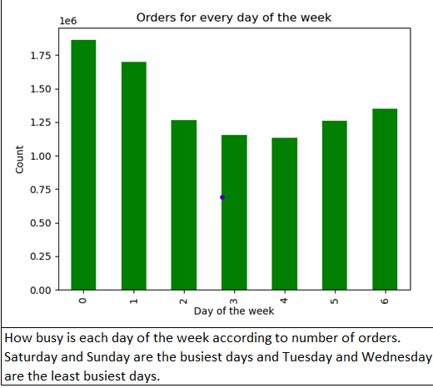
Busiest days
Saturday (0) and Sunday (1) are the busiest days

Slide 27
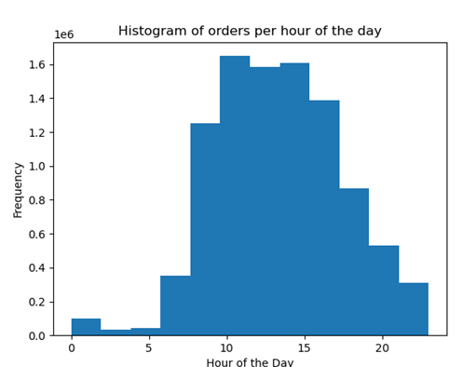
Busiest Hours
The busiest hours, it is possible to notice that the access volume increase at 9 am until 3 pm, when start to decrease.

Slide 28
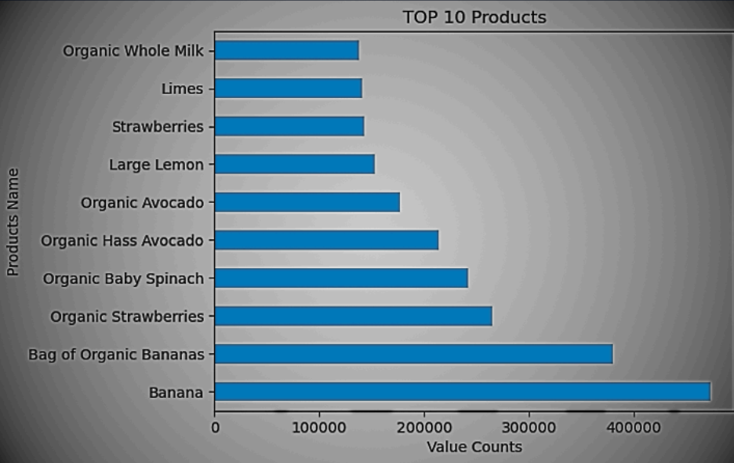
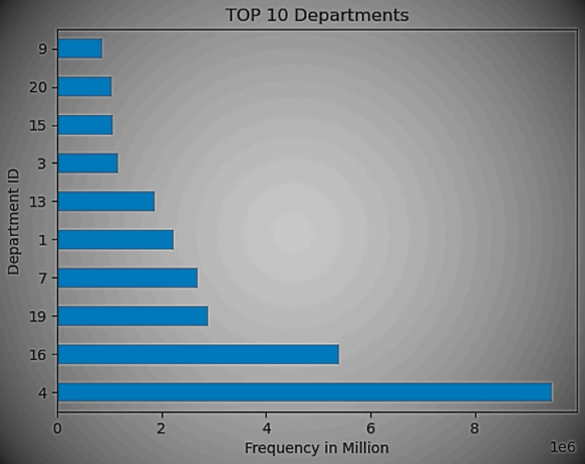
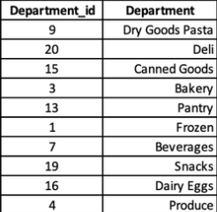
Top Products and Departments
As can be observed, the top 10 products consumed by all regions in the Instacart database are inside the top 1 department in sales frequency, that is "Produce", which could indicate a buying trend by its customers.

Slide 29
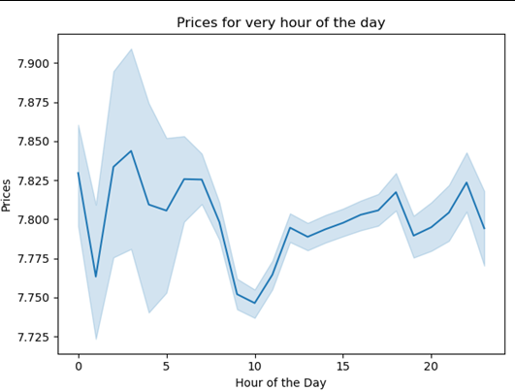
Market Analysis
According to the graph above customers have a higher tendency to sped more between 04 am to 08 am, as well as from 8 pm until 10 pm.

Slide 30
Recommendations
Busiest Day Saturday (0) and Sunday (1) are the days that have a higher frequency of requests. Thus, these days would be the most recommended for an advertising, as it would reach a higher number of people. As for the best period of time to run these ads, considering that from 09 am to 3 pm Instacart has a higher volume of order, this shows a major activity of customers, compared to the rest of the day, increasing the reach of an ad
Top Products Market research could be carried out to assess why these products and departments are so popular and why others are not. From this, the responsible department could study measures to be adopted to increase its sales, such as adding a variety of popular products (i.e. banana) or making combos between products that are popular and others that are not , to assess public acceptance for certain products, studying their viability in the market or replacement with another that is more successful.
Expenditure Habits Considering expenditure habits, it is possible to notice that more expensive products are consumed during the night (8 pm to 10 pm) and early morning (04 am to 08 am). Thus, considering the information regarding the busiest period of time mentioned above, it is possible to use this information to evaluate what type of product should be advertised, depending on the time of day. Thereforre, during the night period (8pm - 10pm) and early morning hours (04am - 08am), more expensive products could be highlighted, while during the busiest period (09 am - 3pm), more affordable products could be featured.

Slide 31

PIG E. B A N K
Analytical support to the anti-money-laundering compliance department thorugh data-related projects that assess client risk and transaction risk, as well as reporting on metrics to support the bank in runnin their complaince program more efficiently.

Slide 32
Goal, Data limitation, and Skills
Data Source https://images.careerfoundry.com/public/courses/data-immersion/A5/A5_Data_Project_Brief.pdf Customer Data Set - By CareerFoundry Tools:
Provide analytical support to company's anti-money-laundering compliance department, through a variety of data-related projects that help the bank assess client risk and transaction risk, as well as reporting on metrics. Also provide support to help build and optimize models that assist the bank in running their compliance program more efficiently
Data does not provide date, so it is not possible to observe whether there was a trend of customer loss during a specific period or whether it is something that occurs constantly.
Intro to Big Data
Data Ethics: Bias, Security and Privacy
Intro to Data Mining
Intro to Predictive Analysis
Time Series Analysis and Forecasting

Slide 33
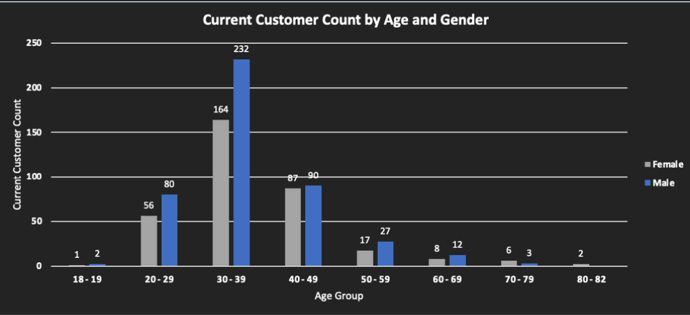
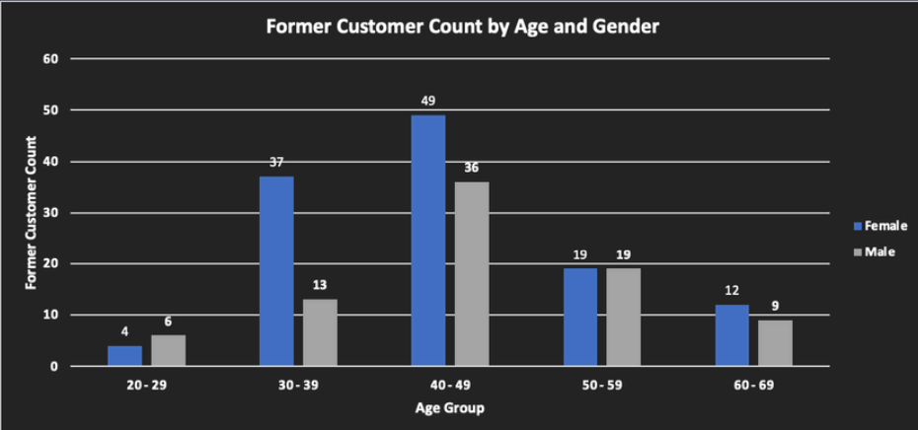
High Risk - Age and Gender
The slides above show that age and gender are risk factors, as: Most of the former customers are in the group of 40-49 years old; Most of the former customers are women.

Slide 34
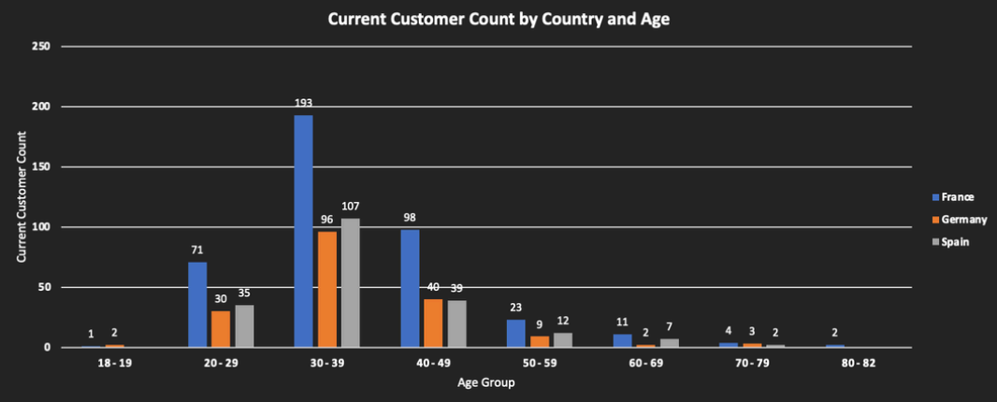
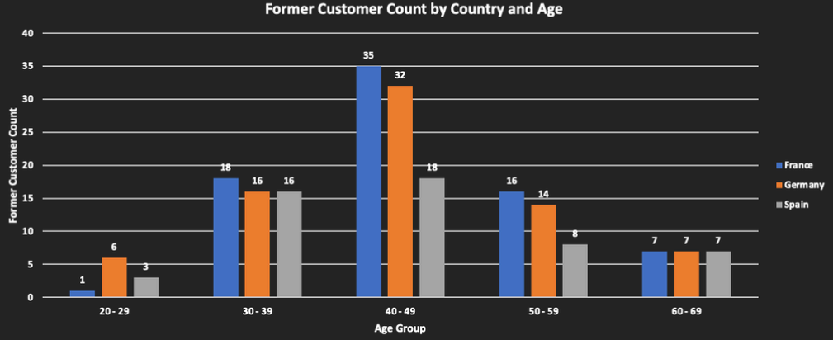
High Risk - Country
Continuing the results shown in the previous slide, Country can also be a high-risk factor as we can notice that there is a high number of people from Germany that leaves the company.

Slide 35
High Risk - Country
Continuing the results shown in the previous slide, Country can also be a high-risk factor as we can notice that there is a high number of people from Germany that leaves the company.

Slide 36
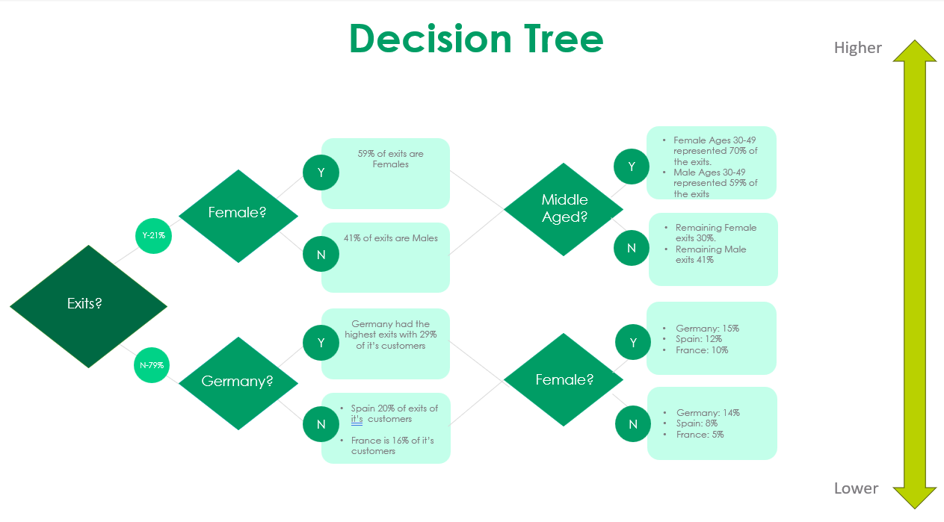
Decision Tree
The Decision tree shows more Females are leaving banks In Germany than France and Spain combined.
Spain 20% of exits customers and France has 16# of exits customers.
The age groups for male and females are 30-49. With 70% females leaving and 59# males leaving.

Slide 37
Recommendations
Focus on young people demographic Considering that the population under 39 years of age constitutes the majority of customers, Women it would be advisable to create programs or products focused on this category of customers, so that the losses caused by older customers who leave the bank could be mitigated.
Therefore, considering that the majority of young customers do not have a consolidated credit score or cannot afford high bank fees, the following services may be attractive:
Creation of an account or special products for people up to an age to be determined by the bank, in which they will not be charged special fees or offer services such as access to credit or mortgage at a reduced rate, even without a credit score, so they can start their life. –
Sign-Up bonuses or Reward Programs: depending on the age of the person opening the account, any benefit can be taken into account when contracting services, which, combined with benefits such as No-fee banking mentioned above, could result in a customer who would remain with the account for longer

Slide 38
About Me
Hello, I’m Robert and I live in Marlboro, New Jersey. I was always curious and enjoyed learning new things, which led me to the field of data analytics.
I hold a Bachelor’s degree in Criminal Justice and Political Science with minor in Critical Intelligence. In the past, I have worked as a Research Analyst with Department of Health in New Jersey, which has helped me develop organizational, problem-solving, and communication skills.
I have also gained analysis and research skills throughout my data analytics journey while utilizing various tools and methods including Excel, Python, SQL, and Tableau.
Now, I am looking for a role that allows me to use my enthusiasm for exploring and uncovering facts while collaborating with other data analysts to expand my expertise in the industry.

Slide 39
Contact
Email Rindeljr@gmail.com
https://www.linkedin.com/in/robert-i-b0714b122/
https://public.tableau.com/app/profile/robert.indelicato/vizzes
https://github.com/rindelicato

